Slide 1


Antifragility in Software
Aka: Build a software that can change

Slide 2
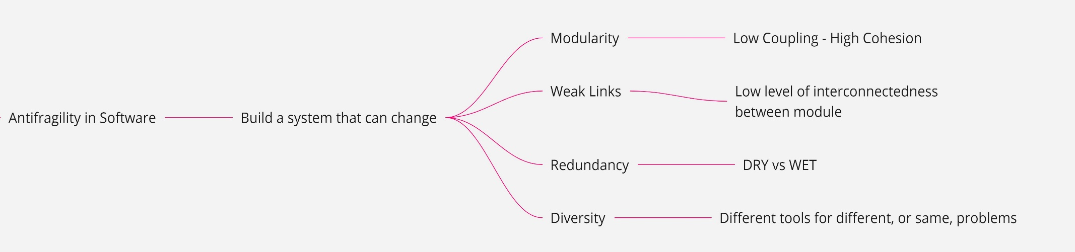

Slide 3


All we need is Data!
Software Architect is Hard
Why have architects struggled with decisions in distributed architectures?
Because Software Architecture is the stuff you can’t Google Bing answers for

Slide 4
All we need is Data!
Lehman’s law of Software Evolution
S-Program
P-Program
E-Program
Written according to an exact specification of what that program can do
P-Program
Written to implement certain procedures that completely determine what the program can do
E-Program
written to perform some real-world activity

Slide 5
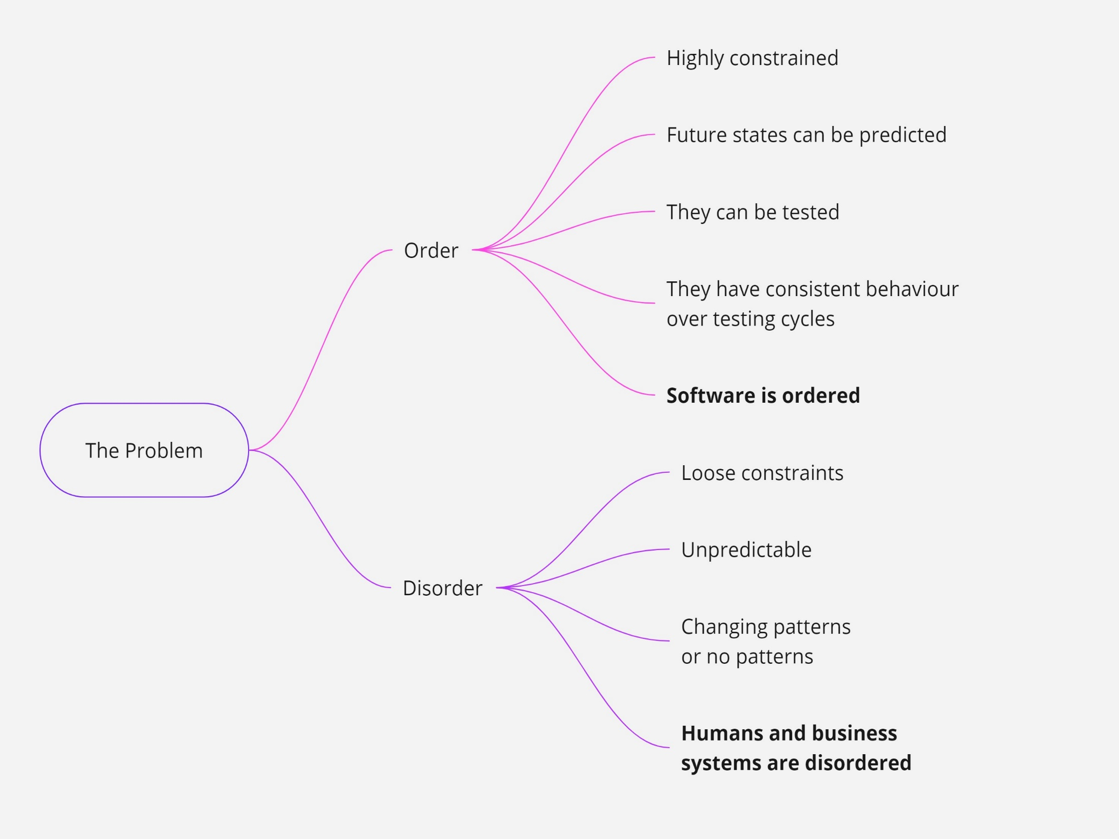
NewVantage Report

Slide 6

Your Model is Over!
A model is not a copy of the real world, but a construct that helps us make sense of a complex system
A model cannot exist without a boundary

Slide 7

Misintegration
Complexity
Complexity is a useful guiding principle.
To design and build an effective solution you have to understand the problem

Slide 8
System is Mutable!
Modularity
Weak Links
Redundancy
Diversity
Low Coupling
High Cohesion
Low level of interconnectedness between module
DRY
vs
WET
Different tools for different, or same, problem(s)

Slide 9
Evolutionary Architecture
An Evolutionary Architecture supports
guided incremental change across
multiple dimensions

Slide 10
Evolutionary Architecture
An Evolutionary Architecture supports
guided incremental change across
multiple dimensions

Slide 11
Evolutionary Architecture
An Evolutionary Architecture supports
guided incremental change across
multiple dimensions

Slide 12
Evolutionary Architecture
An Evolutionary Architecture supports
guided incremental change across
multiple dimensions

Slide 13
Guided
Fitness Functions
An evolutionary computing fitness function characterizes how close a solution is to desire result
An architectural fitness function characterizes how close a system is to the desired architectural characteristics
The code must be maintanable!
(What does that mean?)
Outcomes not Implementations

Slide 14
Principles
Last Responsible Moment
Architect and develop for evolvability
Postel’s Law
Conway’s Law
Take decisions at the last responsible moment, because you have the most information
You cannot change a system you don’t understand
Be conservative in what you send, be liberal in what you accept
Communication patterns

Slide 15
Laws of Software Architecture
First Law
Corollary 1
Second Law
Everything in software architecture is a trade off
If an architect discovered something that isn’t a trade-off, more likely he doesn’t yet identified the trade-off
Why is more important than how

Slide 16

Multiple Dimensions
Application
Operations
Essential
Accidental

Slide 17


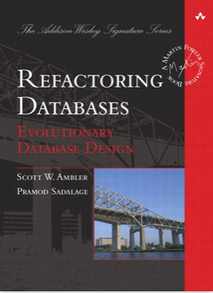



Misintegration
Suggestions
No Silver Bullet - Essence and Accident in Software Engineering
Fitness function-driven development
Five Level of Ignorance
The Cynefin framework

